Slide 1
GRB250205A
aperture photometry of VT data
zhyao@bao.ac.cn

Slide 2
Observation Statics
Date | Subsolar | Image Number
2025-02-05 | 03387 | 97/124
 | 03388 | 107/144
2025-02-06 | 03389 | 56/74
 | 03390 | 55/74
 | 03391 | 48/64
 | 03392 | 44/60
 | 03397 | 0/2
 | 03398 | 56/62
 | 03399 | 55/72
 | 03400 | 53/70
 | 03401 | 56/74
 | 03402 | 52/72

Slide 3
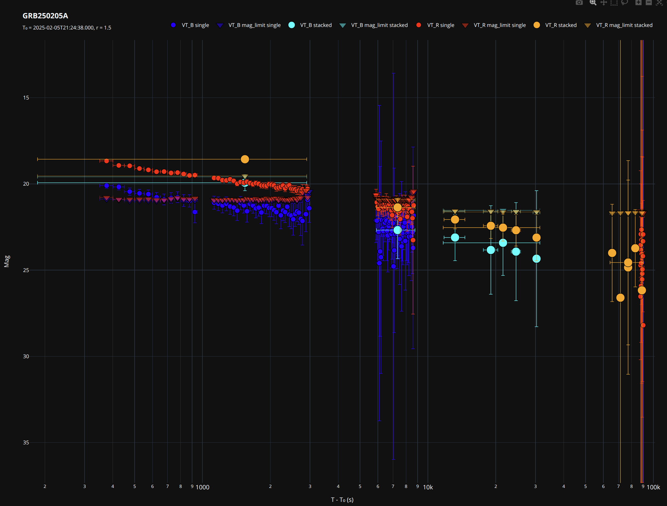
reduc roughly
red and blue circle: single image
orange and cyan circle: stacked image
triangle-down: mag limit
all single and stacked images

Slide 4
check result
From the roughly reduction:
check the data from the first subsolar, maybe give up some good data;
The target is visible, but the error bars are too large, and the calculated limiting magnitude is too high;
Searching for an appropriate image stacking strategy.
1.
2.
2.
3.
3.

Slide 5
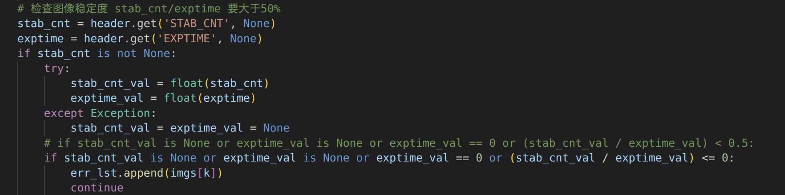
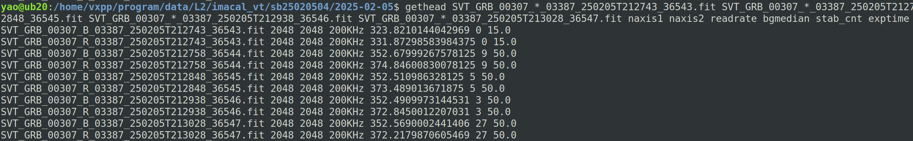
check data 1.
From the roughly reduction:
check the data from the first subsolar, maybe give up some good data;
The data selection criteria are very strict, which removed the first few frames. In fact, the image quality is still acceptable.
1.

Slide 6
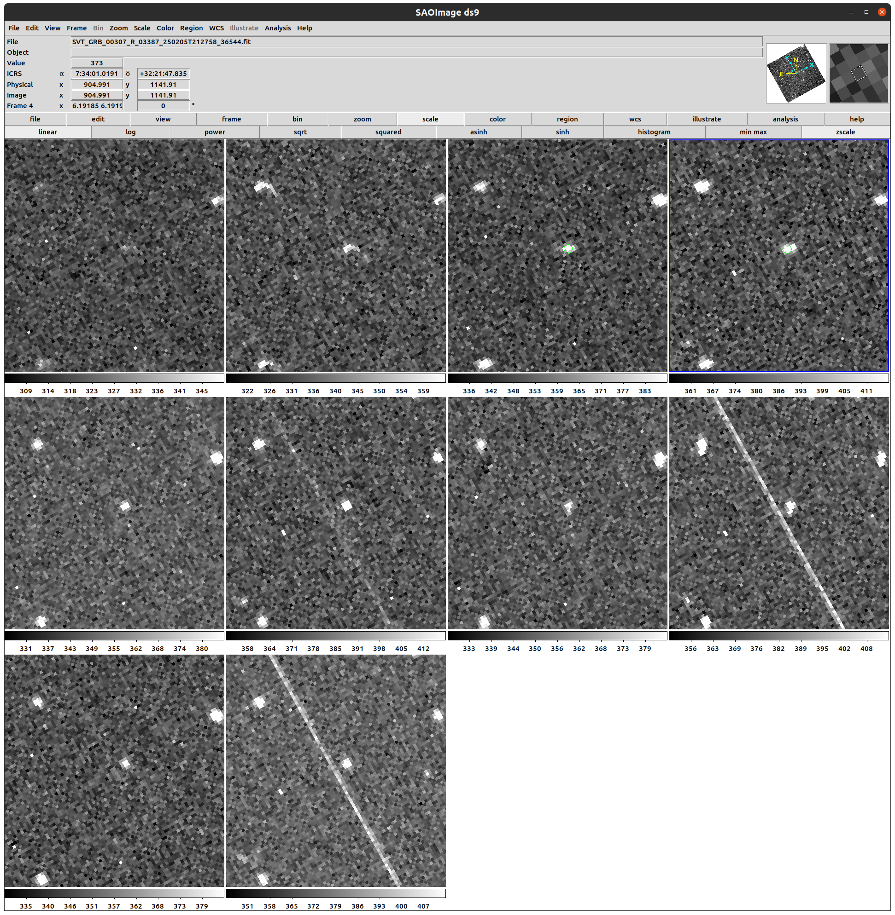
check data 1.
The stars in the first two images appear somewhat elongated, while those in the later images are acceptable.

Slide 7
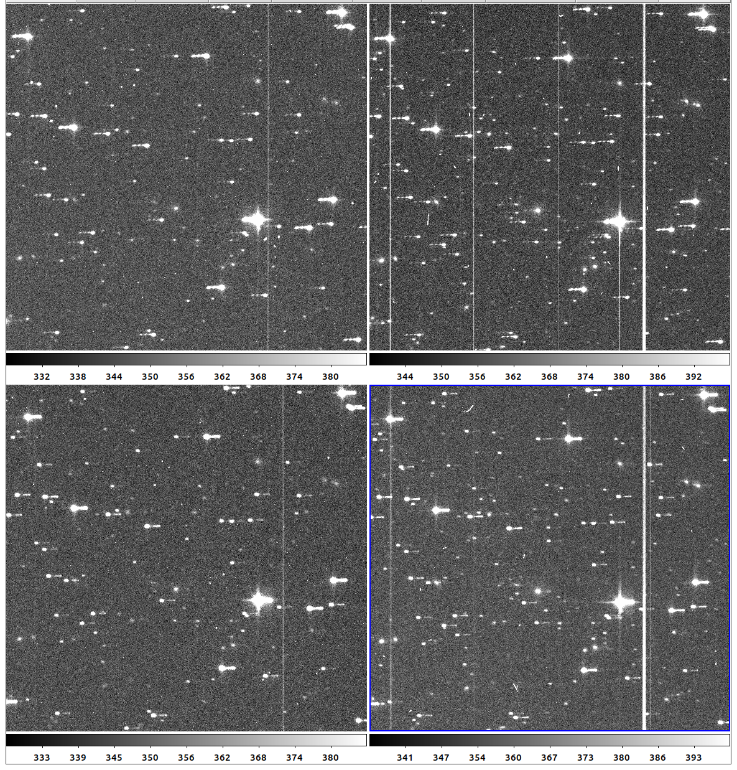
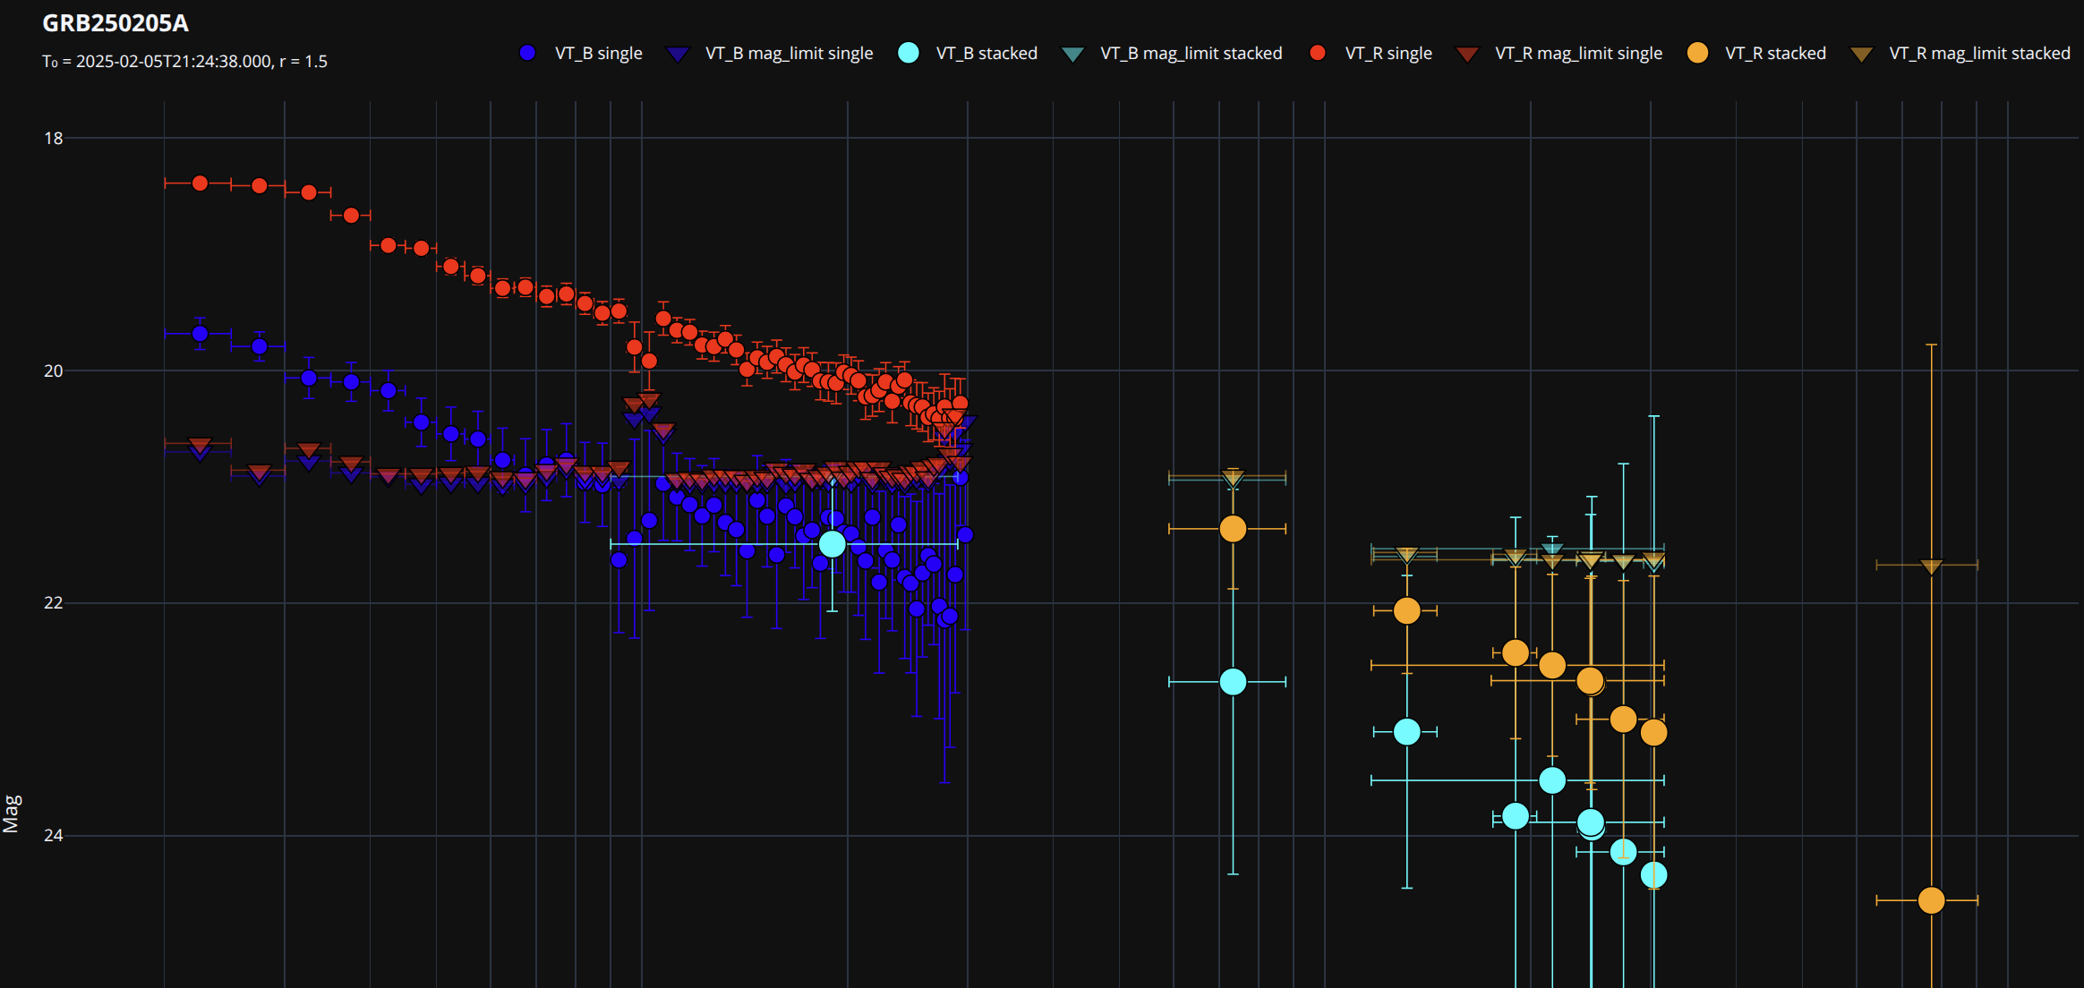
check data 1.
The measurements are inaccurate due to jitter in two images;
they have been removed.
Notes:
“jitter” 在天文、信号处理、图像等领域常指“抖动”，即信号、图像或天体位置等随时间发生的小幅度、快速、随机变化。
在天文图像中，jitter 通常指由于望远镜跟踪不稳等原因导致的星点位置晃动或模糊。

Slide 8
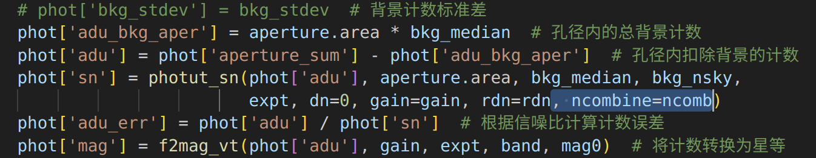
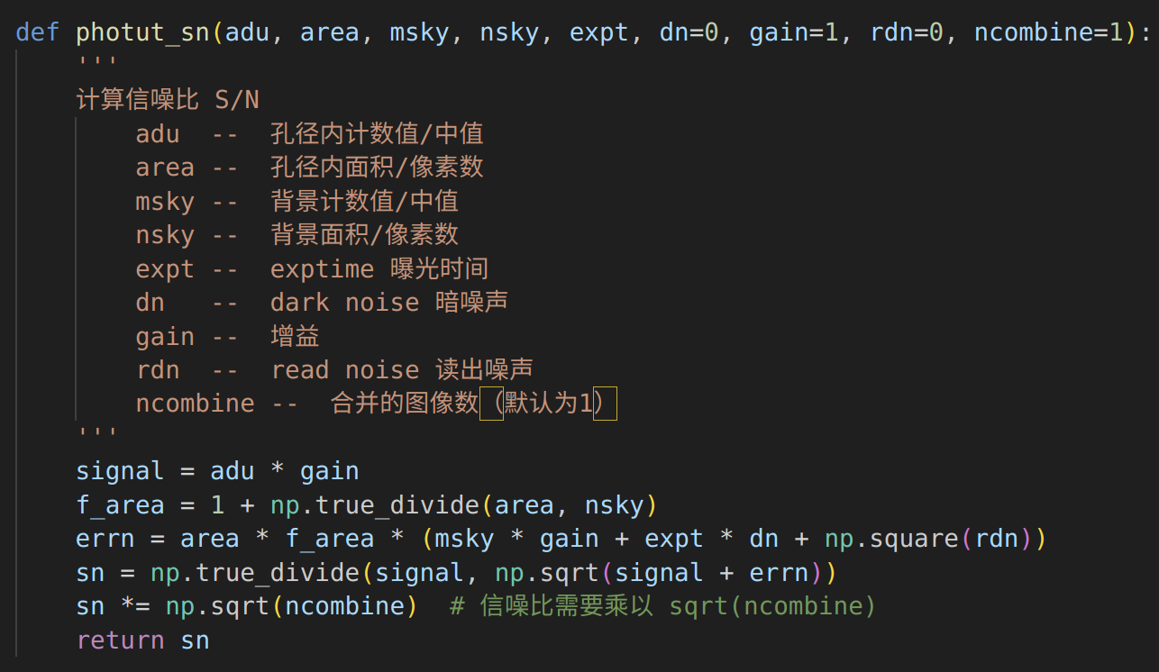
check data 2.
The SNRs for stacked images are incorrect, resulting in issues with the errors and limiting magnitudes.
2.
2.

Slide 9
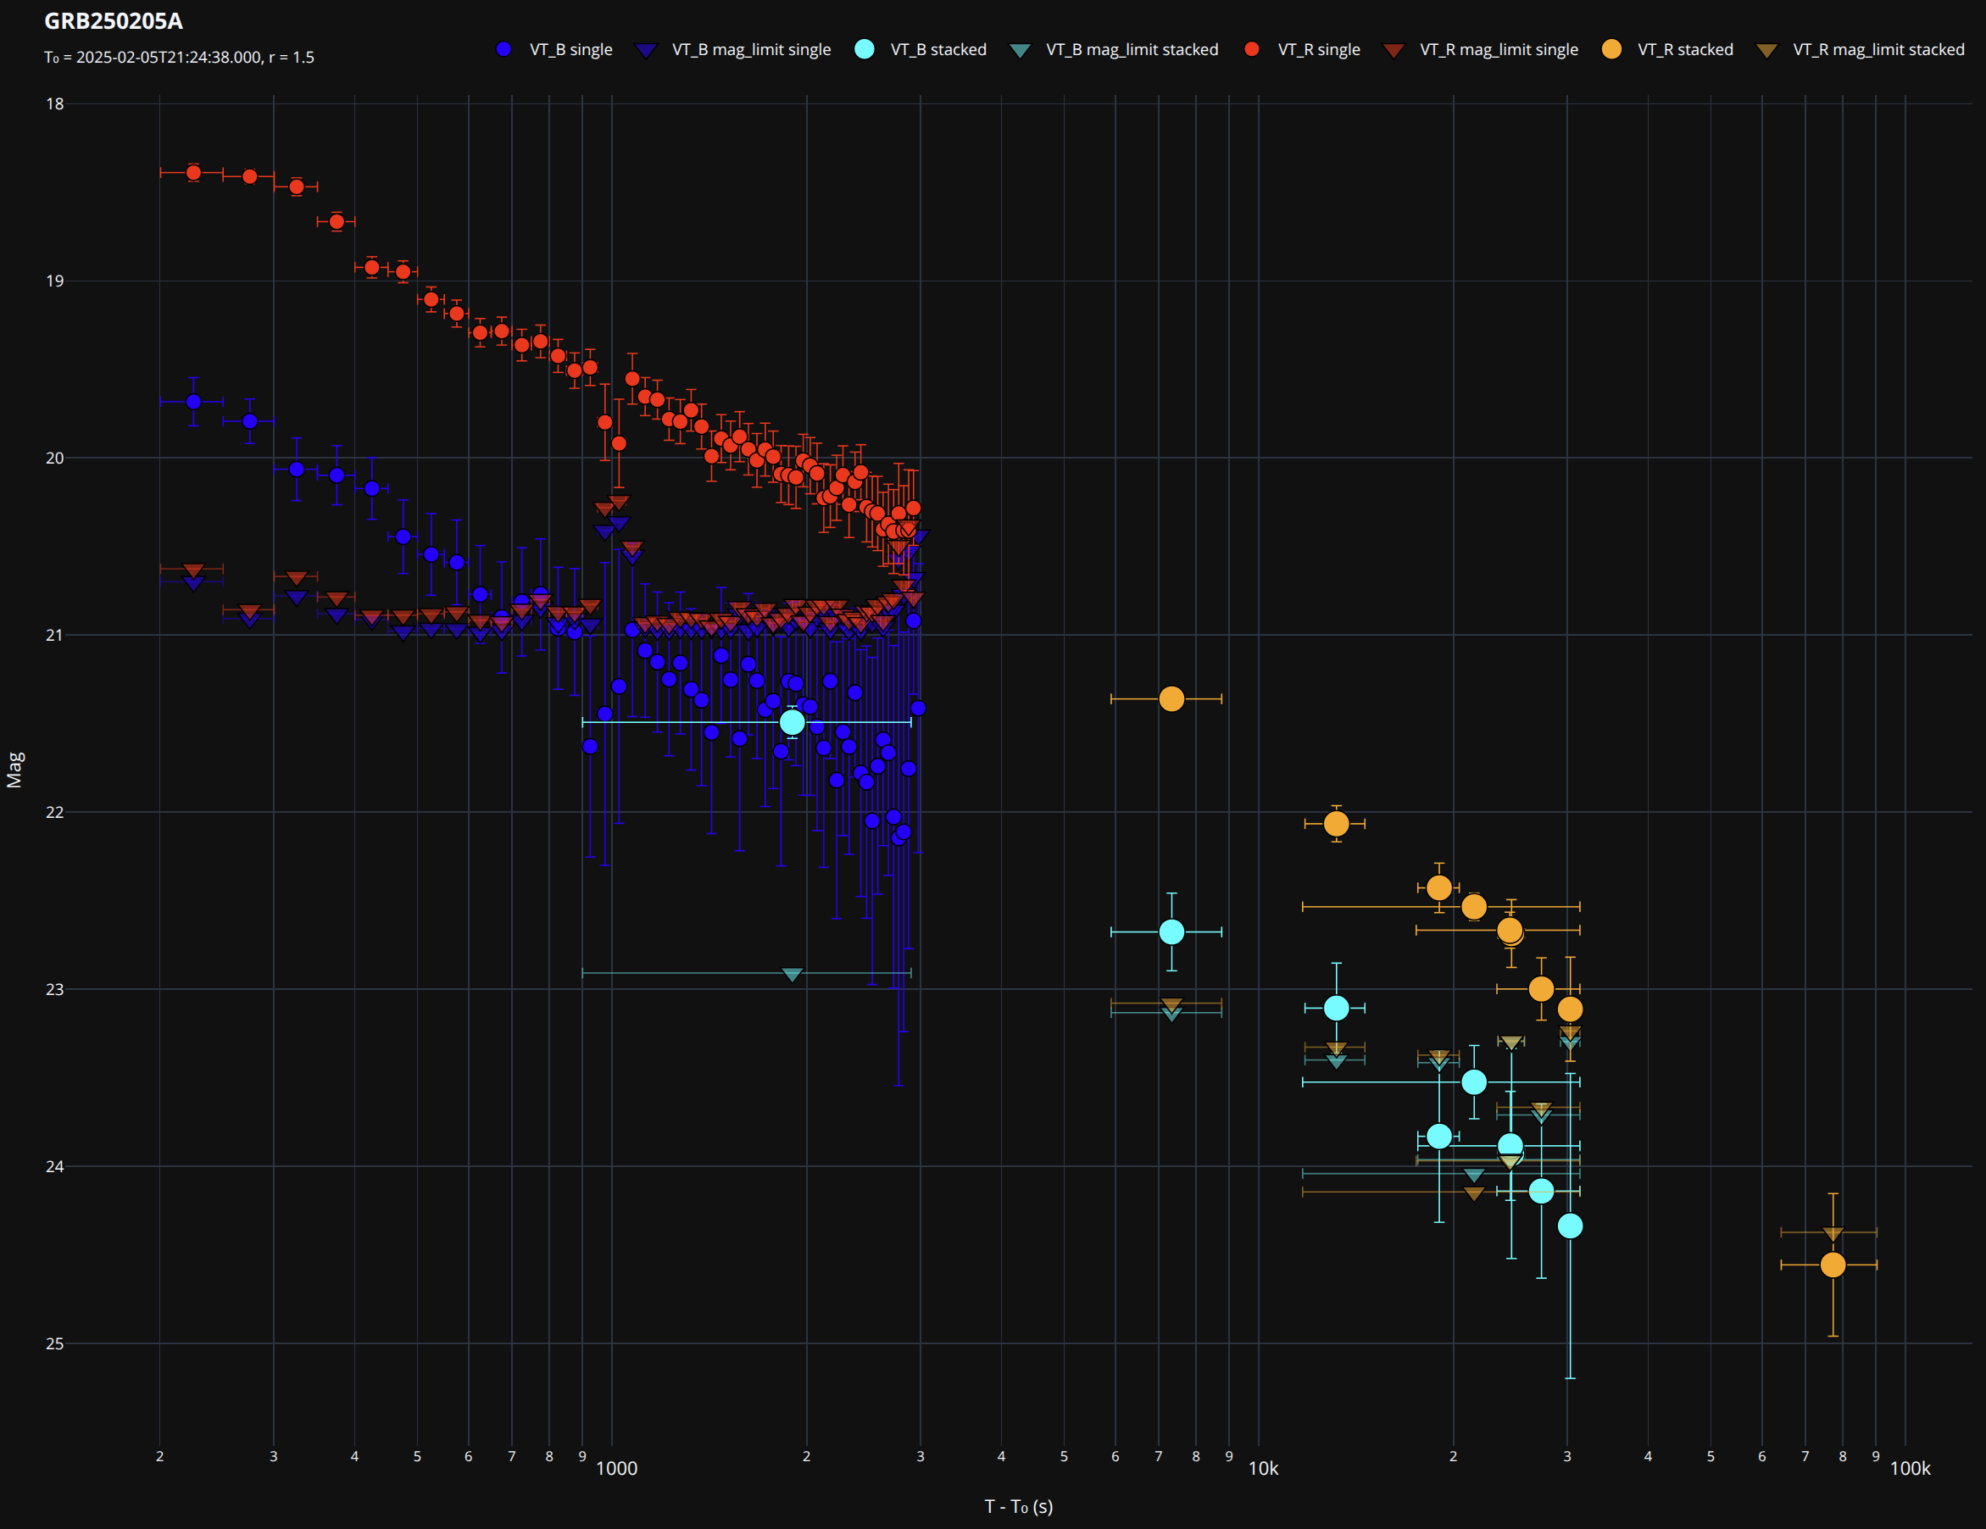
check data 2.
2.

Slide 10
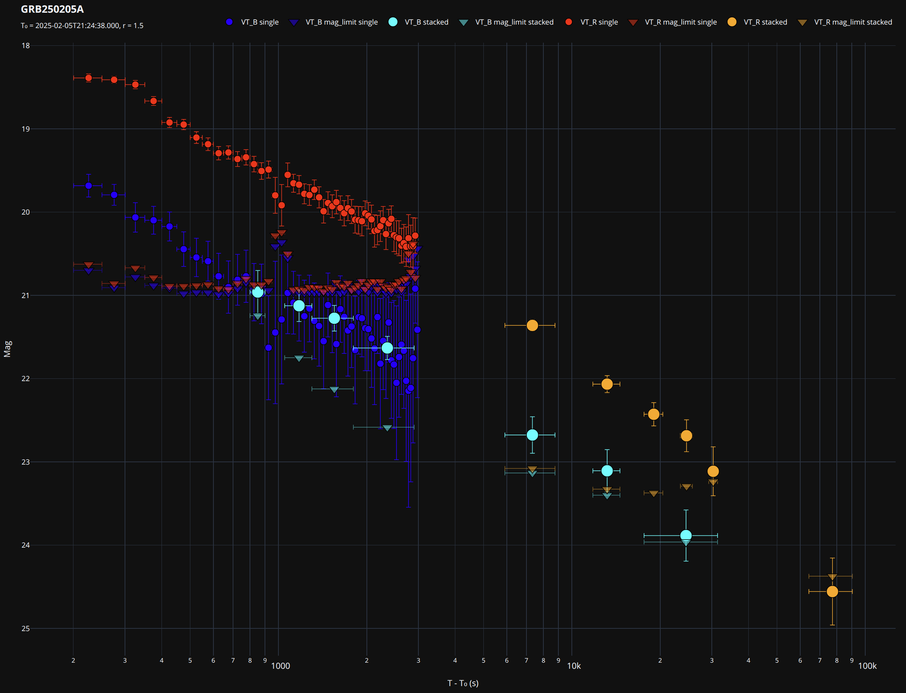
check data 3.
3.

Slide 11
redeuc250711

Slide 12
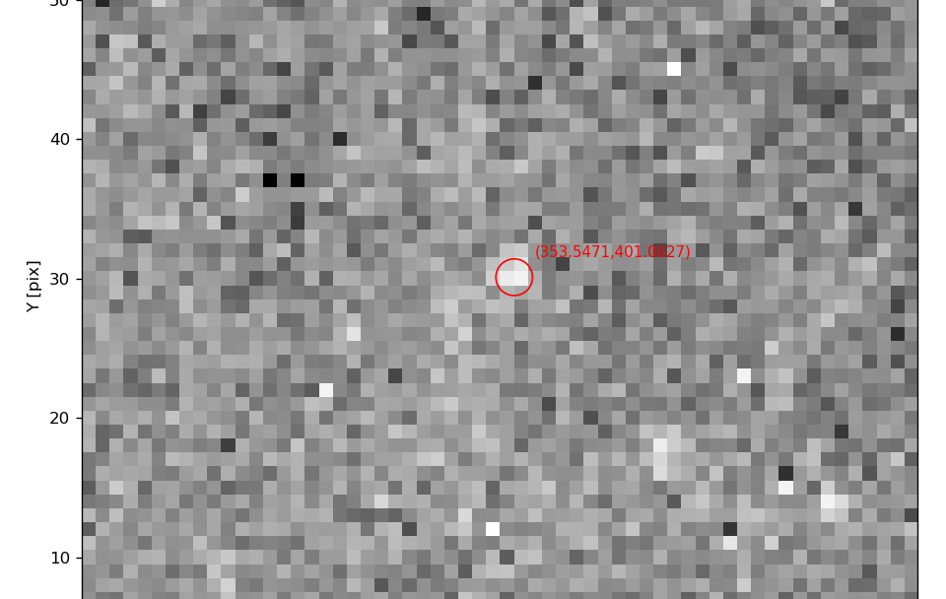
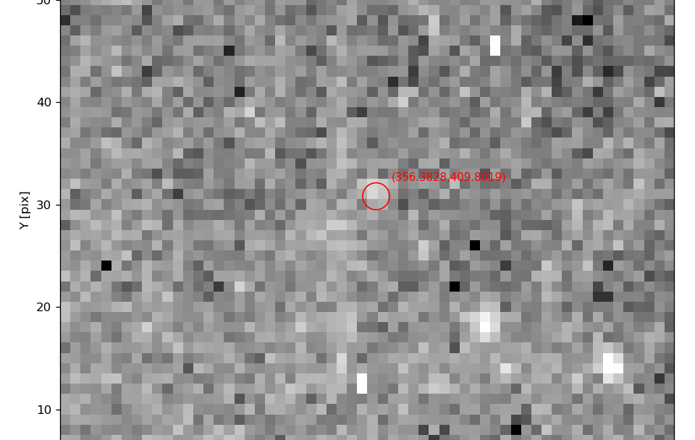
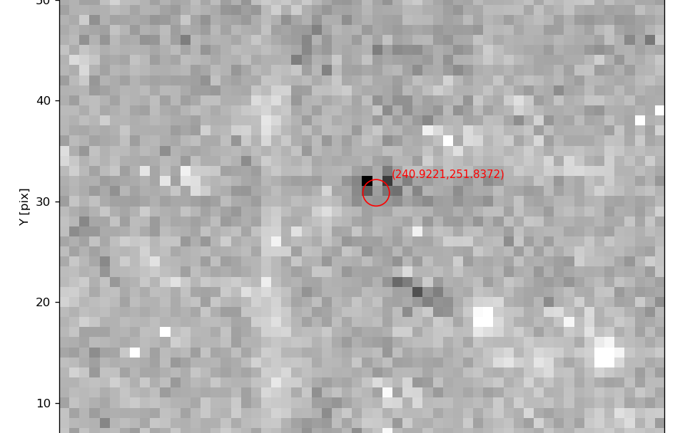
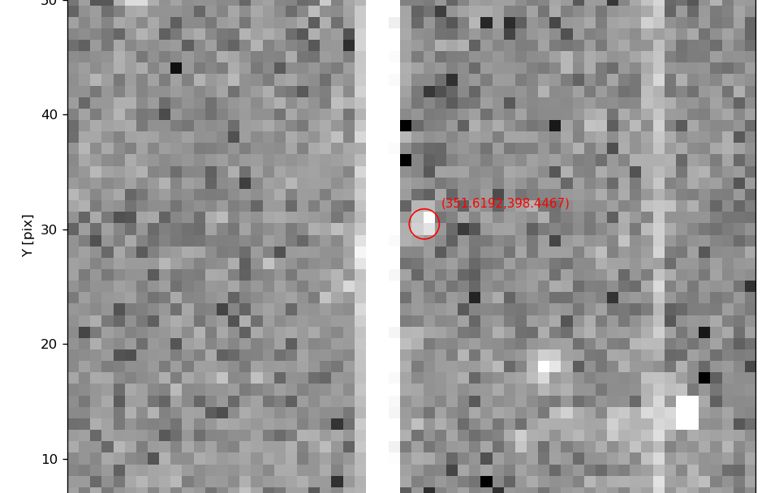
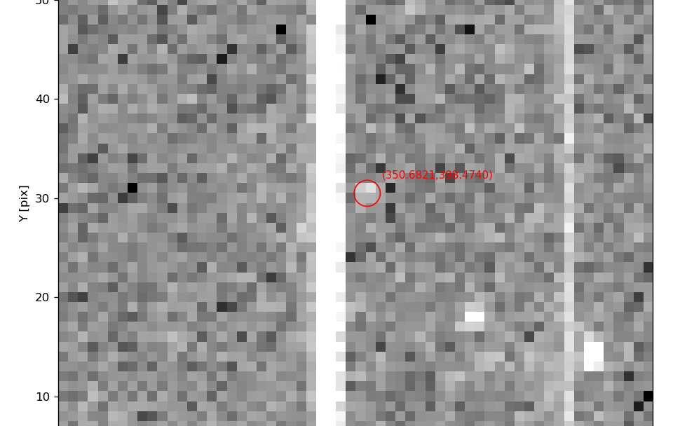
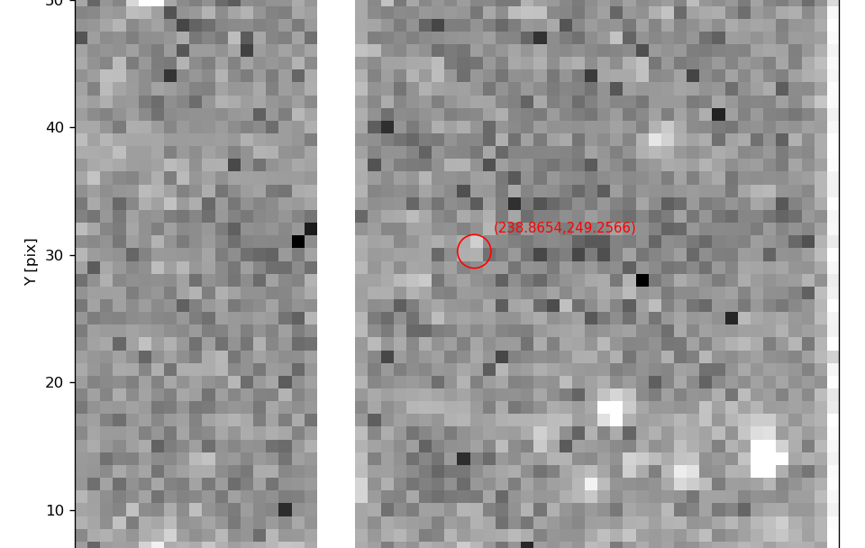
redeuc250711
Last 3 stacked images in both two bands.
3389
3390 3391 3392
3398 3399 3400 3401 3402
3391
3392
3398 3399 3400 3401 3402

